Slide 1
Lesson objective
Title: Multiplying strategies
Aim:
Apply BIMDAS.
Demonstrate mental strategies for multiplication.
Plan:
Daily review
BIMDAS
Multiplication strategies

Slide 2
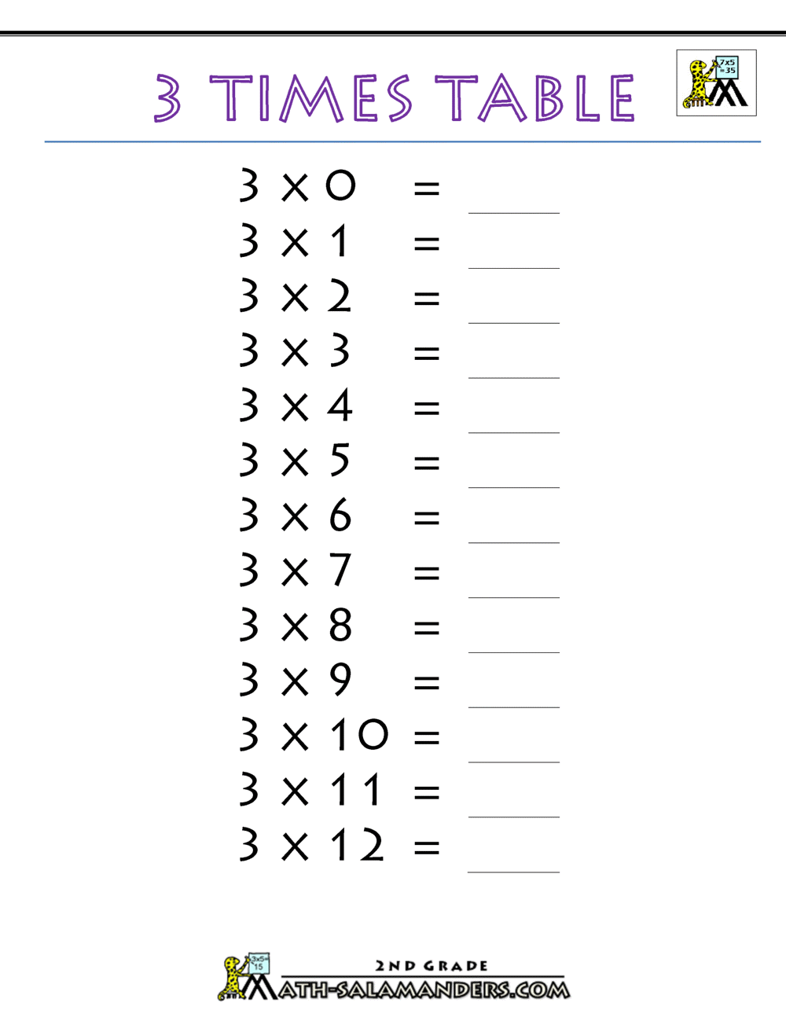
Daily review: on your whiteboards
B_________ I_________ M________ D________ A________ S________
Use the lattice method:
22 x 24 =
2 | 2
 |  | 2
 |  | 4
KEEP THIS ON YOUR WHITEBOARD

Slide 3
BIMDAS video
PEMDAS is BIMDAS but with different names
Parenthesis are Brackets
Exponents are Indices
https://www.youtube.com/watch?v=ZzeDWFhYv3E
During practise, I can come around and help people.
It is very important that we remain on task so I can focus on those that need it (R.E.A.L)

Slide 4

Whiteboards
Follow with me:
2 + (3 x 3) – 6
$$3^{2}+8 x 2+\left(9 −4\right)$$
$$\left(3 −5\right) x 2+10 ÷\left(−2\right)$$

Slide 5

Whiteboards: you do
$\left(9 −7\right) x 2=$
$4^{2} −10 ÷2=$
$\left(3^{2}+2\right)+\left(5 −10\right) x 3=$

Slide 6
Multiplication strategies - rational numbers.
There are a number of written strategies for multiplying rational numbers.
The standard algorithm:
36 x 24
2
36
X 24
1
4
14
Use the ones digit first
2
7
0
Use the tens digit second.
Don’t forget to put a zero
864
Add them up

Slide 7
Standard algorithm
On your whiteboards copy me:
15 x 22 =
23 x 45 =
Your turn:
18 x 42 =
21 x 46 =

Slide 8
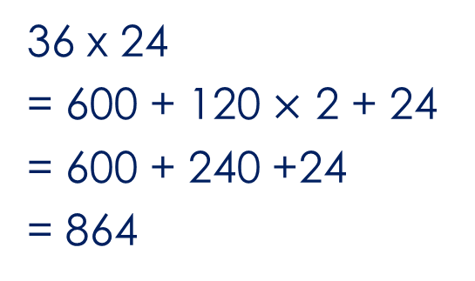
The grid method:
36 x 24
30
6
600
120
20
36 x 24
= 600 + 120 $×$ 2 + 24
= 600 + 240 +24
= 864
120
24
4

Slide 9
The lattice (Chinese) method:
36 x 24
3
6
0
1
6 x 2 =12
2 x 3 = 06
6 x 4 = 24
3 x 4 = 12
Add the diagonals
6
2
2
1
2
8
2
4
4
6
4
36 x 24
= 864

Slide 10
The doubling (Egyptian) method:
36 x 24
Left (36)
1
2
4
8
16
32
Right
24
48
96
192
384
768
36 = 32 + 4
36 x 24
= 96 + 768
= 864

Slide 11
Doubling method
On your whiteboards copy me:
5 x 145 =
Your turn:
18 x 42 =

Slide 12
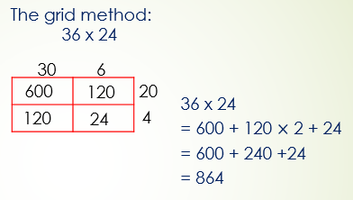
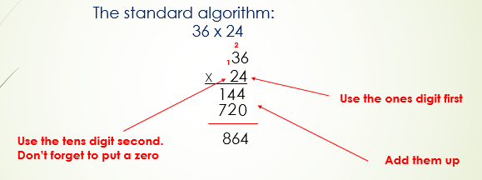
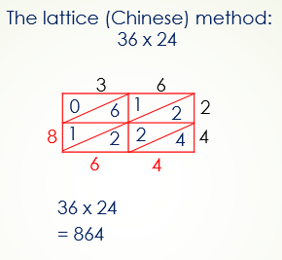
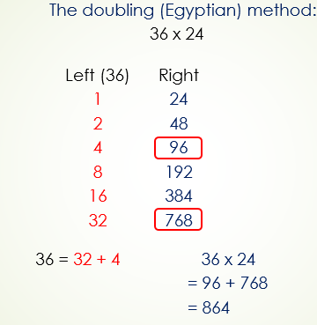
The 4 multiplication strategies.
Standard Algorithm.
Doubling method.

Slide 13
Calculate 127 x 34 using each of the 4 multiplication strategies.
Standard Algorithm.
Grid method.
Lattice method.
Doubling method.
Notes:
Worksheet 1

Slide 14
Lattice method: decimals
The number of decimal places in the question must equal the number of decimal places in the answer.
The number of decimal places in the question _________the number of decimal places in the answer.
The question has 4 decimal places, how many decimal places will be in my answer?

Slide 15
Multiplying decimals.
The number of decimal places in the question must equal the number of decimal places in the answer.
 | Number of decimal places in question | Answer
12.7 x 3.4
1.27 x 3.4
0.127 x 34
127 x 0.34
0.127 x 0.34
0.0127 x 3.4
Notes:
Worksheet 2

Slide 16
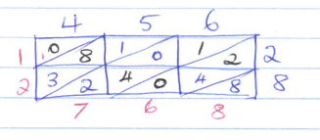


Independent practice:
eg: Calculate 4.56 x 2.8
$$∙$$
Calculate each of the following:
4.7 x 2.6
3.9 x 54
2.34 x 6.7
0.59 x 1.8
0.621 x 27

